Slide 1

Design and Implementation of
a secured online attestation portal (ETTEST)
Presented By :
Sidhant Khokhar (RA1711003010142)
Ankit Bengani (RA1711003010162)
Supervisor :
Dr. C. Jothi Kumar

Slide 2

PROBLEM STATEMENT :
The use of technology is increasing nowadays. On the other hand, most governments and university offices still do not use technology to implement simple things such as signing a document because they still rely on face-to-face to ensure the authenticity of the signatory. Several challenges may come while signing documents online such as, how to authenticate the signing parties and how to ensure that signing parties will not deny their signatures in future? Students/Employees face a lot of problems while getting attestations for their documents, as the present system is not flexible, accessible to all and is not secured.
EMNINENT PROFESSOR:
Dr Wanpeng Li
wanpeng.li@abdn.ac.uk
OVERSEAS LAB:
Cybersecurity, Information Protection, and Hardware Evaluation Research | GTRI (gatech.edu)
REFERENCE PAPER:
Tamper-Proof Certificate Management System - IEEE Conference Publication (BASE)

Slide 3
TABLE OF CONTENTS
ABSTRACT
INTRODUCTION
LITERATURE SURVEY
INFERENCE FROM THE SURVEY
INNOVATION IDEA OF THE PROJECT
PURPOSE
OBJECTIVES
SCOPE
PRESENT SYSTEM
PROPOSED SYSTEM
UML
ARCHITECTURE
METHODOLOGIES
RESULT
REFERENCES

Slide 4
Abstract
Document Authentication is one of the most tedious as well as important job in today’s world. We need attested documents in each and every sphere of life.
We need attestation even in schools and colleges while submitting projects and research papers.
However with this epidemic and lockdown everything came to a standstill, every college, government office and other civic bodies were closed to common people.
Prior to this situation many institutions and official firms used a physical mode of providing attestation.
But with the lockdown and the fear of transmitting disease, many firms and institutions moved to online form of attestation, one which is more convenient in today’s fast moving world.
In this project we aim to provide a more secure and diverse platform for the same work.
Based on the dynamic behaviour of the communication entities, the model can not only achieve dynamic authorization, but also overcome the complex management issue of role-based remote attestation

Slide 5
Introduction
The proposed project consists of 4 sided model
Applicant Side: which allows user to request for attestations, upload documents, create his/her ID.
Authority Side: which allows user to attest the document, secure mode of contacting the applicant in case of issues.
Admin Side: for office side verification
Registration Portal : Allows user to register
The user is sent an encrypted link embedded in a QR which is decrypted using the mobile app.
Encryption and decryption follows AES symmetric key encryption and decryption.
The registration portal uses a verifyer and an authenticator which verifies an applicant and maintains it’s sessions.
The architecture of the proposed site is developed using html, CSS, and JavaScript.
In case of conflicts options such as video call service is embedded in the web site to resolve the issue.

Slide 6
Literature Survey
Author and Research Paper | Concepts | Advantages | Disadvantages | Publication
Al Anood K. Alzahrani, Malak K. Alfosail, Maryam M. Aldossary, Muneera M. Almuhaidib, Sarah T. Alqahtani Nazar A. Saqib, Khalid A. Alissa, Norah A. Almubairik Secure Sign: Signing Documents Online | The Secure Sign aims at making the e-signatures secure and confidential. It uses various technologies such as AES Encryption, user fingerprints and user id embedding in the documents using QR barcode. It aims at making the e-signing as secure as possible | The Secure Sign provides a very secure and tamper proof system of signing documents. It can be used in a wide range of areas where from school to businesses etc. It reduces the risk of frauds and forgery | There is no facility of two people signing the document making is unusable in most situations. There is no use of PDF417 which could have been more efficient as it generates a QR for greater number of characters. There can be more factors added to the authentication such as signature analysis and multi-biometric feature | Published in : 31st December 2018 21st Saudi Computer Society National Computer Conference (NCC)

Slide 7
Hani Sami Brdesee, King Abdulaziz University, Jeddah, Saudi Arabia An Online Verification System of Students and Graduates Documents and Certificates: A Developed Strategy That Prevents Fraud Qualifications | Verification of documents and resume is an important step in job recruitment and admission procedure. The system proposed removes the need of verification of these documents via traditional means and propose and online portal where all these things can be done for students both in the country and outside the country | The University can stay in touch with its students anytime and can cater to their needs and issues. The system improves job recruitment process by going through all the documents and checking for fraudulent information | The use of system might not be user friendly, as there might be a lack of access of rights for each service. Scaling up of the system imposes a trouble as the number of students and universities increase. | Published in : April-June 2019 International Journal of Smart Education and Urban Society, Vol. 10, Issue 2
Nikita I. Chesnokov, Denis A. Korochentsev, Larissa V. Cherckesova, Olga A. Safaryan, Vladislav E. Chumakov, Irina A. Pilipenko Software Development of Electronic Digital Signature Generation at Institution Electronic Document Circulation | This paper focuses on the investigation of the approaches to formation of digital signatures as well as intends to find the software developing the electronic signatures and how to make it a secure system. | The addition of additional security module increases the crypto-stability of the system | It is difficult to compare the developed model with the existing models also because of lack of ease to get commercial signatures. | Published in : 15th October 2020 2020 IEEE East-West Design & Test Symposium (EWDTS)

Slide 8
Jiaohong Shi, Jinsong Ouyang eSign: An Enterprise Portal for Secure Document Management | The purpose of this portal is to fulfill the need of signing and verifying important documents by trusted officials and thereby converting the paper based businesses to e-business processes | The system is pretty much scalable and can be used by large enterprises as well. It supports multiple document formats and hence is more convenient | The system uses a central database to store all the signatures, thus making the data highly vulnerable. There aren’t multiple layers of security and no authentication of the people signing the documents. | Published in : 12th September 2005 IRI -2005 IEEE International Conference on Information Reuse and Integration, Conf. 2005
Raghav, Nitish Andola, Rakhi Verma, S. Venkatesan, Shekhar Verma Tamper-Proof Certificate Management System | Certificates are the most important documents in a person’s life, they are the proof of accomplishments. However these documents can be easily forged due to ineffective anti-forge mechanism. This paper proposes a system that keeps the management, generation and issuance of certificates tamper-proof by using IPFS(Interplanetary File System) and Hyperledger. | Only authorized entities are allowed to generate certificates. The proposed system will provide integrity, privacy and anonymity to each user. | The use of hyperledger makes the system very complicated and also network-fault intolerant. The IPFS consumes a lot of bandwidth | Published in : 6-8 December 2019 2019 IEEE Conference on Information and Communication Technology

Slide 9
Inference from the survey
We need a secure and global system for the attestation as the systems proposed in all the papers above use either means that are not scalable or means which are very complex.
A common thing lacking in each of the above models is the lack of authentication for the user or authority for each session.
There are no means to resolve any conflict between applicant and authority.
Multiple signatures from different authorities can be achieved.
The systems will only be accessible to only two part of institutions, say admin and applicant or admin and authority, not all three.
The systems that focus on the e-signing part do not focus on the verification of the document and the system that focus on the verification part ignore the signing and validation part. Our proposed system focuses on both.

Slide 10
Innovation Idea of the Project
The idea behind the project comes from the in-availability of proper attestation portals, and the problems faced by students/people in getting the attestation.
The idea is to introduce more flexibility and add more features in the current system.
To introduce a proper authentication system using encryption and embedding the verification link in the QR.
To stop any kind of illegalities such as document fabrication.
Reduce the complexity of the present system by replacing the verification system with a more secured one, reducing verification load on offices and hence increasing flexibility.

Slide 11
Purpose of the project
To provide a proper and secured attestation portal to the employees and student.
The proposed project not only adds more features to the current system it also strengthens the security of the process and maintains its integrity.
The proposed methods also make the procedure of getting attestation more streamlined and hence making it less hectic for both the authority, and the applicant.

Slide 12
Objectives
Designing a web based architecture to support a 4 tiered portal namely the applicant, the authority portal and the admin portal.
To make a registration portal to allow user to register for the site.
To make the applicant portal which allows an user to create a profile, upload documents and request for attestation.
To make the authority portal which allows an user to create a profile, download documents, upload attested documents and raise conflict tickets if a problem arises.
To make an admin portal which allows the office the organization to verify the identity.
To provide an option such as a video call to resolve any conflicts raised during the process.
To make the website secure by adding an open SSL certificate.
To make the verification of identity by using a android mobile app.

Slide 13
Scope
The project can be pitched to institutions or small companies that doesn’t have a valid/secure online procedure in place to take up this mode of attestation.
This portal can also be generalized to provide certificates, in physical absence of the applicant.
Support for payment can be added in future in case it is needed by the institute or the company.
Support for academics can be added in future.

Slide 14
PRESENT SYSTEM :

Slide 15
PRESENT SYSTEM
Our Tamper-proof certificate approach shows in Fig:1 contains 5 entities: Authorized Party is a trusted party like Fig. 1.
Our System Model university, school, etc used to generate a legitimate certificate using web-portal.
User wants to download his certificate from authorized party to prove his authenticity to verifier.
The authenticity of certificate sent to user is verified by using hyperledger. Hyperledger stores the certificate and user parameter in the blockchain generated by authorized party which is authenticated by MSP.
IPFS is used to store the certificate in a decentralized structure. So that, there is no single point of failure in the network.

Slide 16
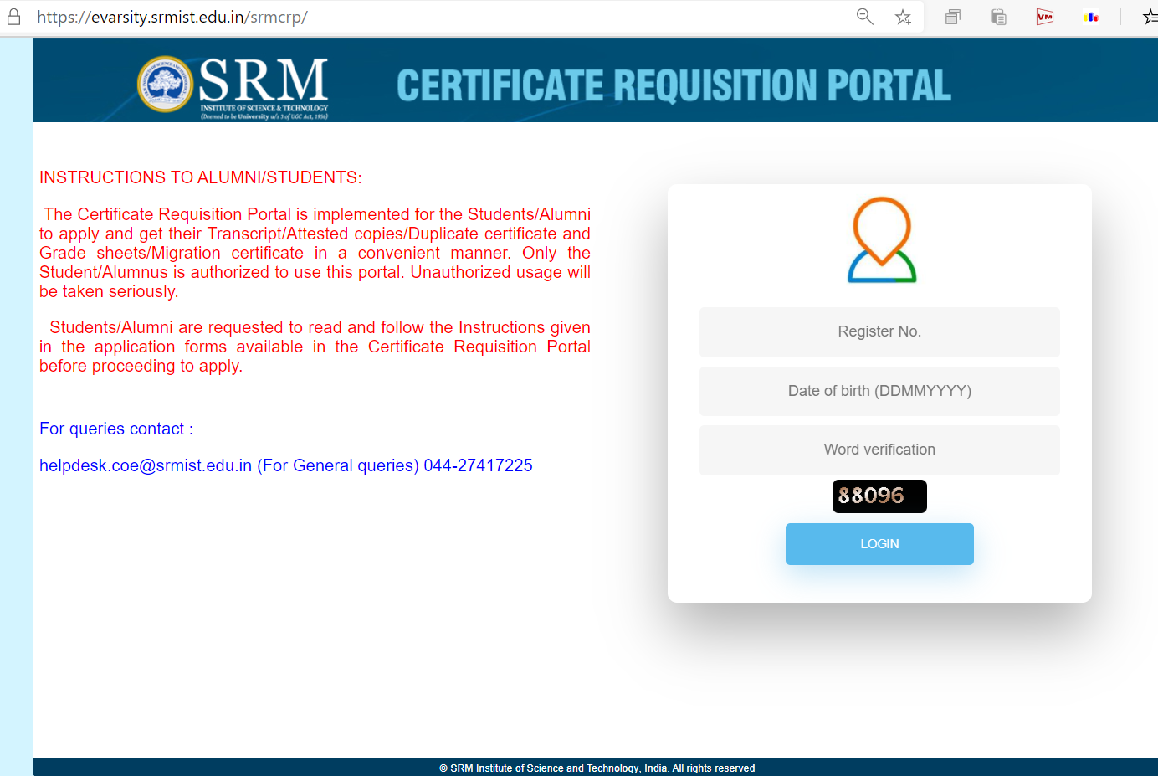
CASE STUDY 1 :
SRM UNIVERSITY ATTESTATION PORTAL

Slide 17
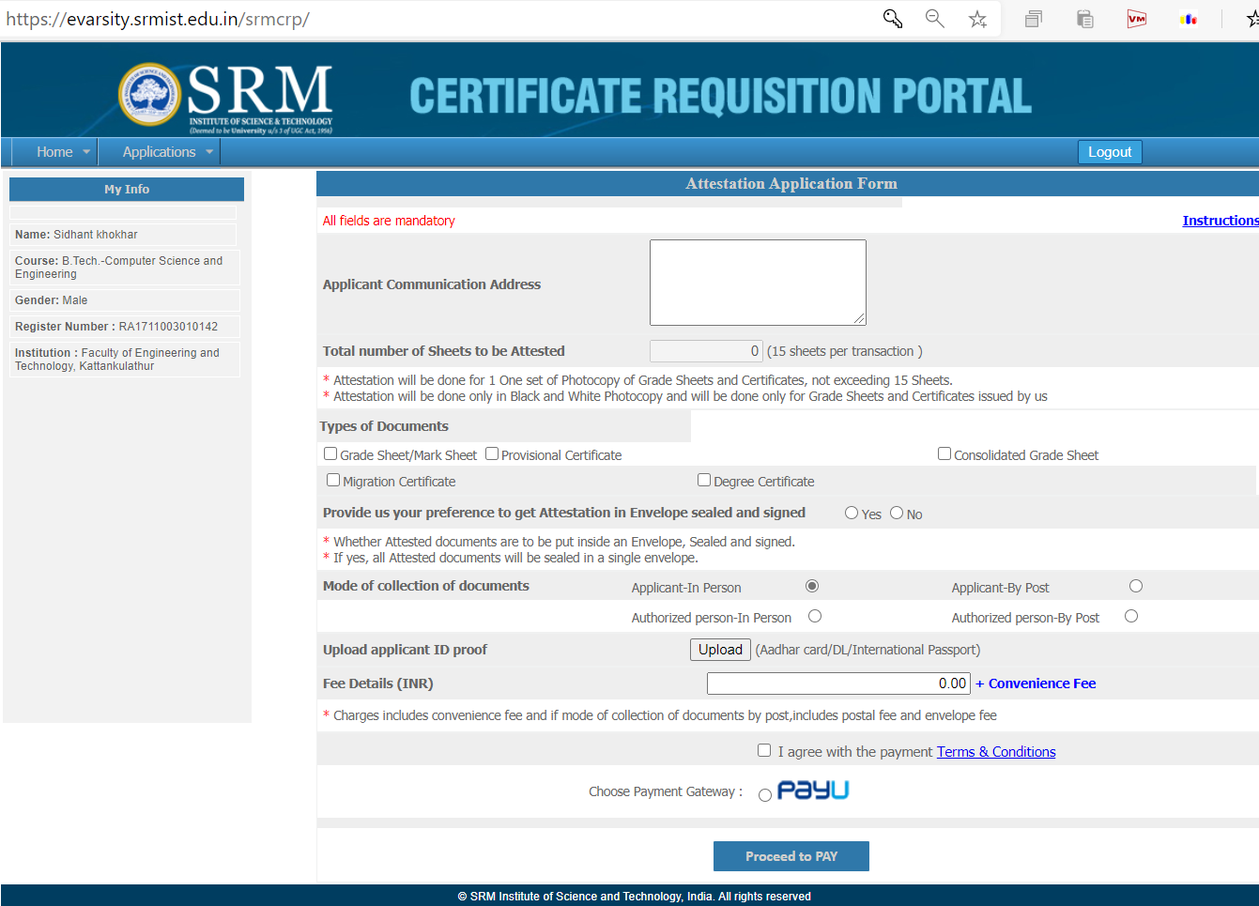
CASE STUDY 1 :
SRM UNIVERSITY ATTESTATION PORTAL

Slide 18
CASE STUDY 1 :
SRM UNIVERSITY ATTESTATION PORTAL
LIMITATIONS:
Login procedure not secure, as no means of verification of identity is used.
No registration portal available.
No means of resolving a conflict or any applicant support is available.
Limited documents allowed to be uploaded for attestation.
Not accessible to all the authorities such as FA and Professors.
Processing time of a request is extremely high due to unavailability of a streamlined process.
Multiple Authority Signature facility not available, some documents are needed to be signed by multiple people which currently is not supported by the platform.

Slide 19
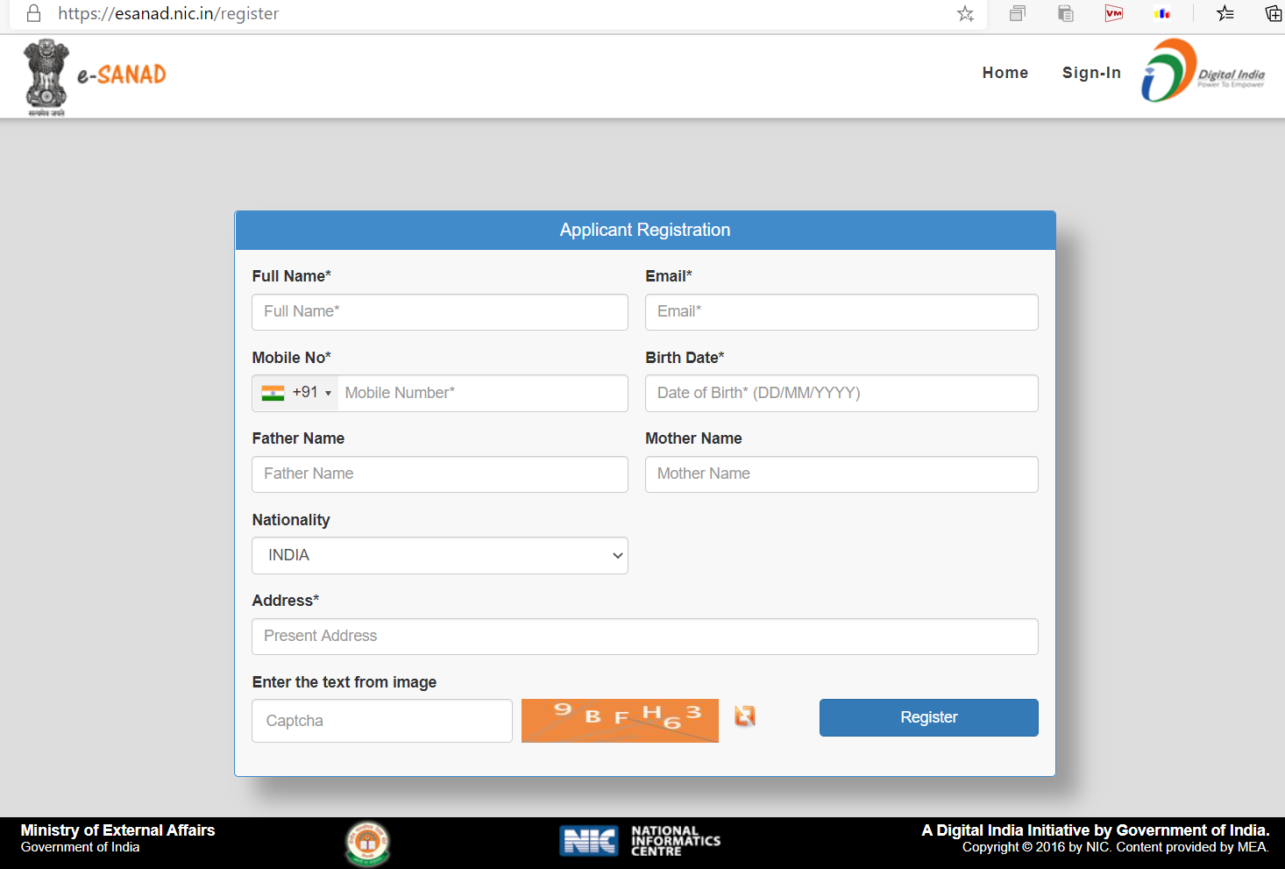
CASE STUDY 2 :
NATIONAL ATTESTATION PORTAL (e-sanad)

Slide 20
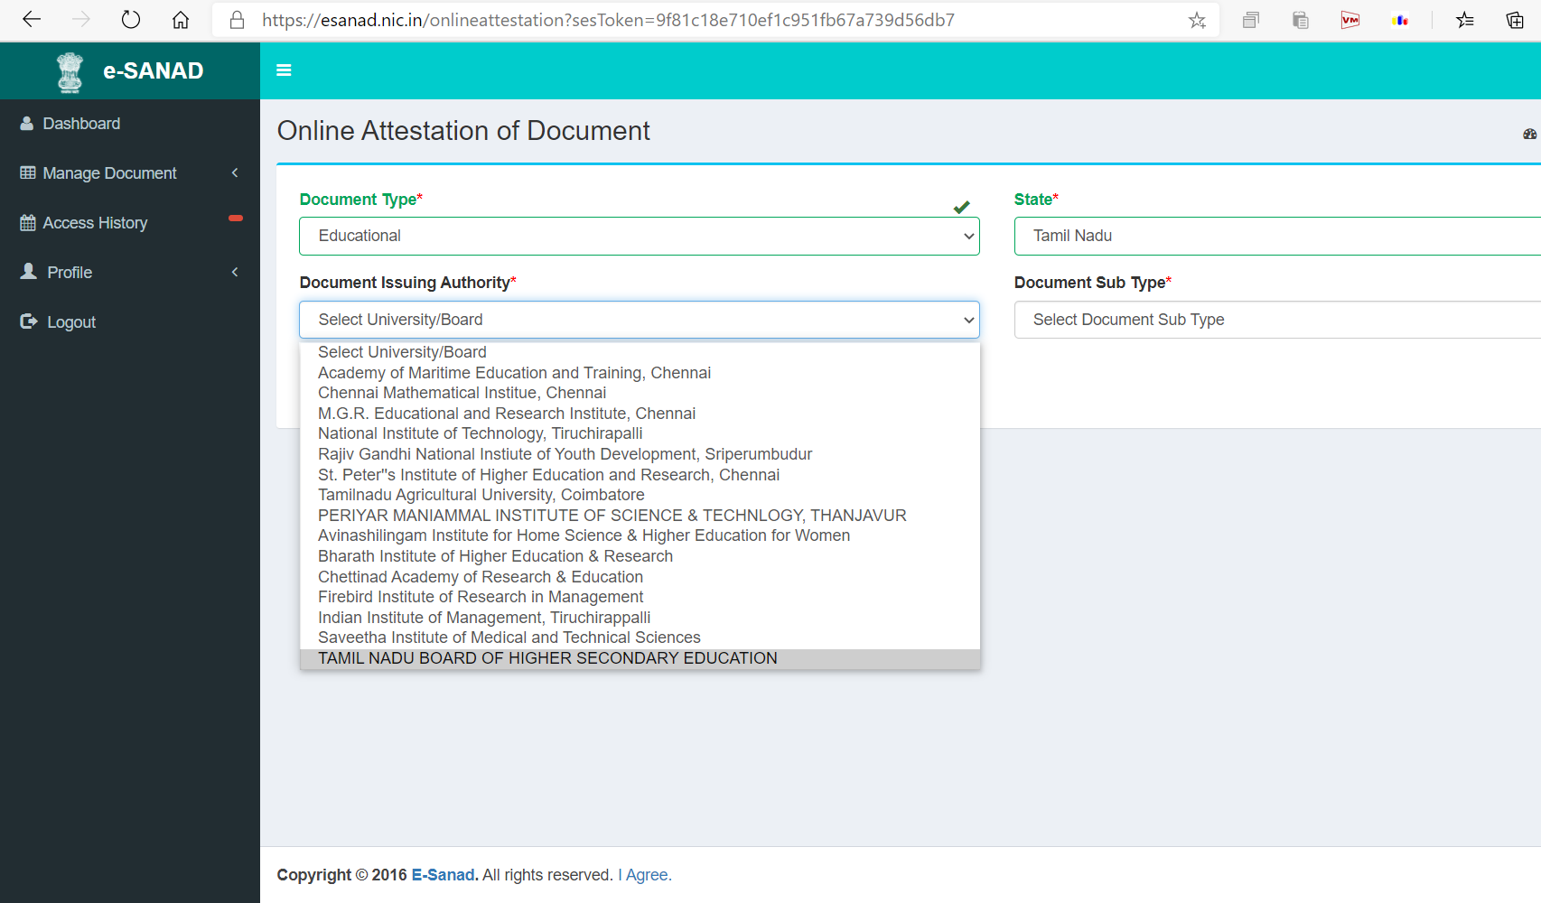
CASE STUDY 2 :
NATIONAL ATTESTATION PORTAL (e-sanad)

Slide 21
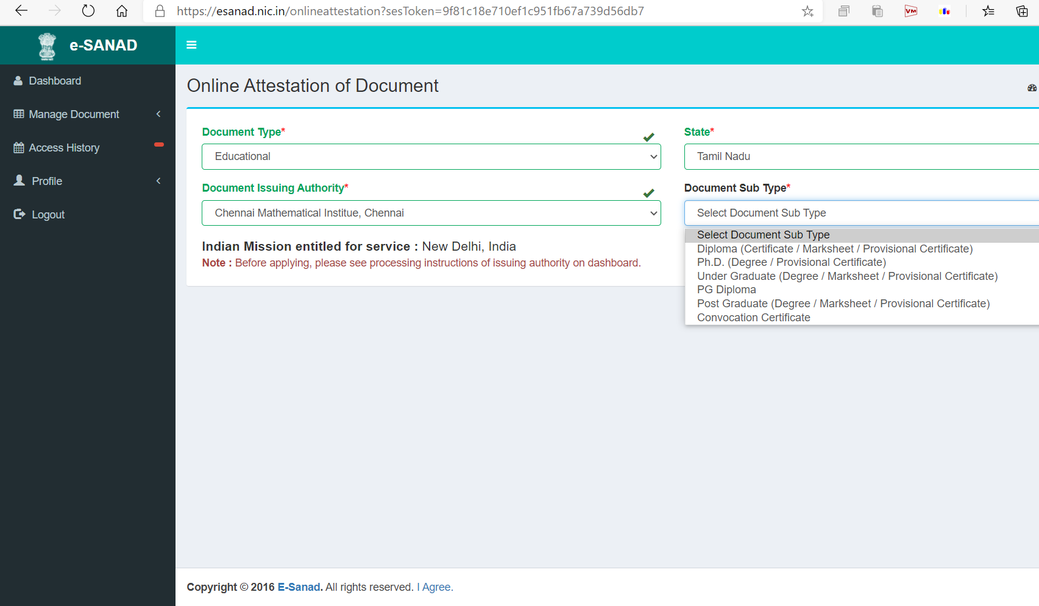
CASE STUDY 2 :
NATIONAL ATTESTATION PORTAL (e-sanad)

Slide 22
CASE STUDY 2 :
NATIONAL ATTESTATION PORTAL (e-sanad)
LIMITATIONS:
Registration procedure not secure, as no means of verification of identity is used.
Is prone to fake identity/document fabrication.
No means of resolving a conflict or any applicant support is available.
Limited documents allowed to be uploaded for attestation.
Processing time of a request is extremely high due to unavailability of a streamlined process.
Multiple Authority Signature facility not available, some documents are needed to be signed by multiple people which currently is not supported by the platform.

Slide 23
Proposed System
The proposed project consists of four sided model:
Applicant Side
Authority Side.
Admin Side
Registration portal
Both the applicant and the authority are allowed to register for the portal, making it accessible to all.
The applicant gets to choose which type of document he wants to upload, and authorities he needs signature from.
The verifyer consists of the registration portal and the mobile app, on the registration portal using the username and the password a symmetric key is calculated which is used to encrypt the registeration link, this link is decrypted by scanning through a mobile app where the user has to enter the username and password again and after calculating the symmetric key the link is decrypted and later redirected.
The verifyer uses a token generating mechanism to maintain user session and the authenticity of the requested attestation.

Slide 24
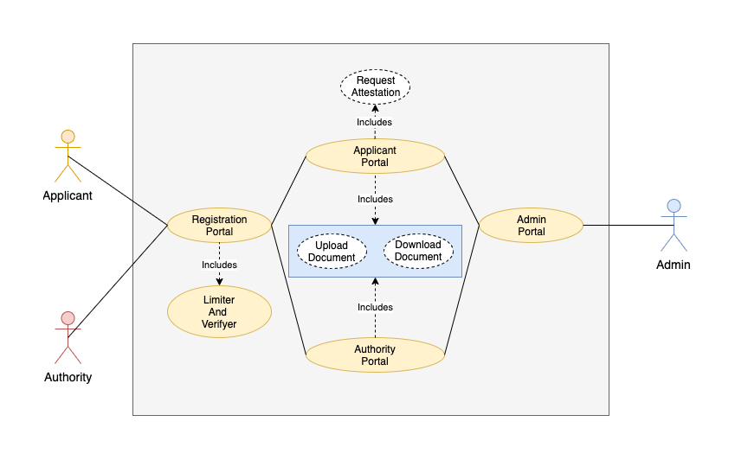
UML Diagram

Slide 25
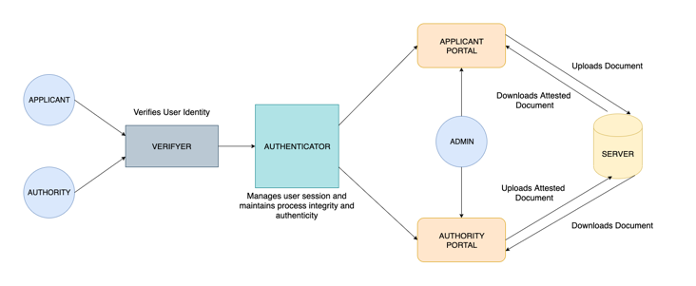
Architecture Diagram

Slide 26
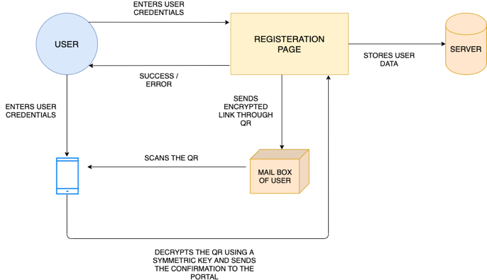
Methodologies
Fig : Verifyer

Slide 27
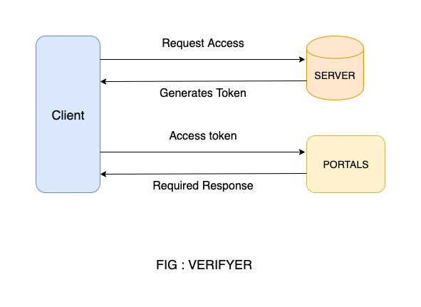
Fig : Authenticator

Slide 28
IMPLEMENTATION:
Verifyer : Android App and the Registration portal
Authenticator : Python scripts
Securing the websites : OpenSSL certificate
Conflict resolution tech : Google/Zoom meet
Languages for making portals : HTML, CSS, Javascript
Software : Google Chrome
OUTPUT:
A working prototype of a portal that allows user and authority to register for it and verifies their identity and allows them to ask for attestation or give attestation respective to their roles.

Slide 29
HARDWARE AND SOFTWARE REQUIREMENTS
HARDWARE
Intel Core i7-7700HQ Processor
6M Cache, up to 3.80 GHz
Has DDR IV 16GB
DDR4 SDRAM
100 GB Hard disk/SSD
SOFTWARE
Windows 10
HTML browser preferably Google Chrome

Slide 30
BENEFITS OF PROPOSED SYSTEM
Is more streamlined and less hectic than any of the portal currently available.
More secured as it has an SSL certificate and an identity verification procedure in place
Modes to allow applicant support and resolve conflicts are provided.
Multiple signatures from different authorities can be achieved.
Accessible to all Authorities and Applicants approved by the institution/organization.
The proposed system is not prone to any illegal activities such as document fabrication as identity verification is done at both applicant side as well as the authority side.

Slide 31
TRADE-OFFs PRESENT SYSTEM VS PROPOSED SYSTEM
PRESENT SYSTEM
More complex
Needs more memory space
Easy to temper with
Slow
No conflict resolution available
No site security
Support for only e certificates
PROPOSED SYSTEM
Less complex
Needs less memory space
Hard to temper with
Faster
Conflict resolution available
site security is given using openSSL
Support for all types of documentation

Slide 32
REFERNCES:
https://esanad.nic.in/
https://evarsity.srmist.edu.in/srmcrp/
authentication - How does Google Authenticator work? - Information Security Stack Exchange
http://qpleple.com/how-to-make-people-login-into-your-website-with-their-google-account/?fb_comment_id=fbc_10150173502428237_23388744_10150972953433237

